Slide 1



UNIT 2: Home is where heart is
The place I call
home

Slide 2
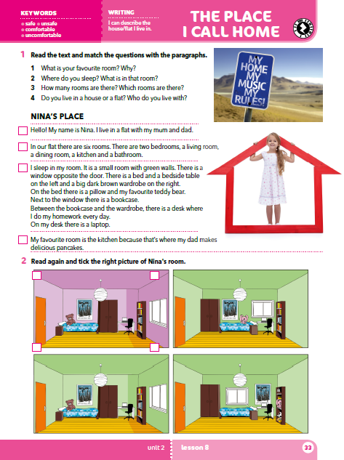
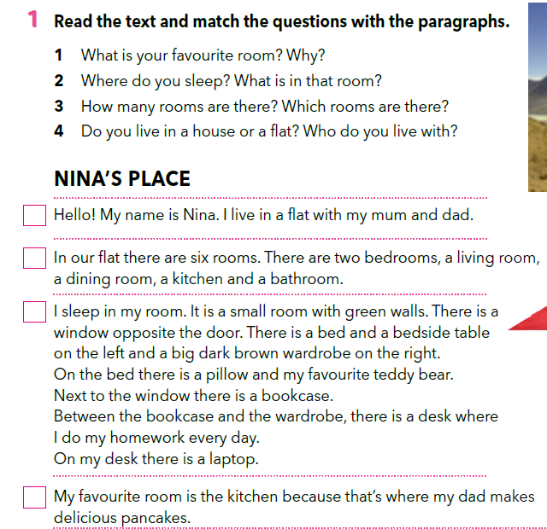
Read the text and match the questions with the paragraphs.
4
3
2
1

Slide 3
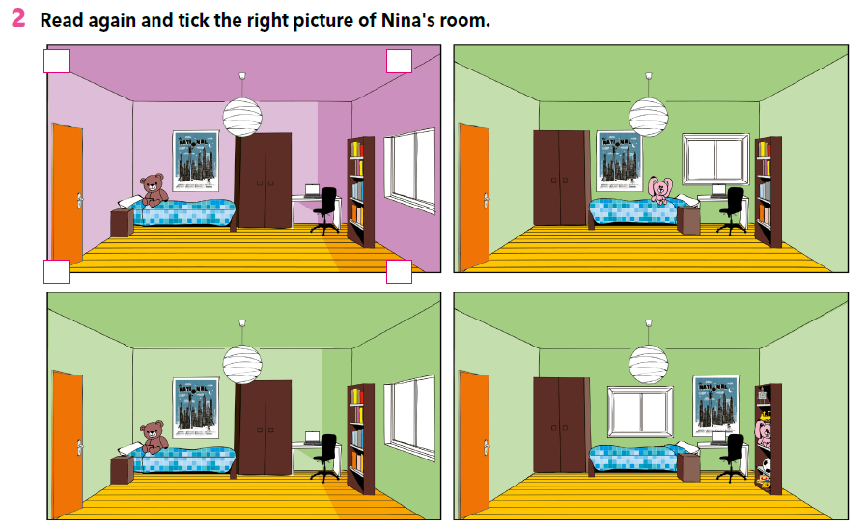
Read the text again and tick the right picture of Nina’s room.


Slide 4
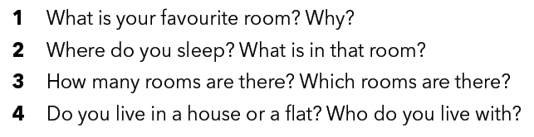
Interview your friend about his/her home.
Use the questions from task 1.

Slide 5
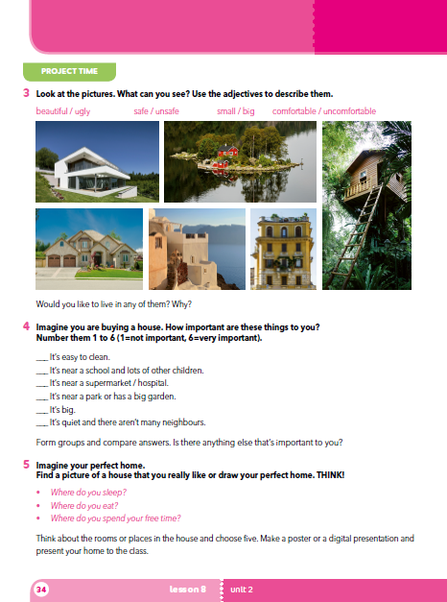
PROJECT TIME
tRANSLATE
safe – siguran unsafe – nesiguran
comfortable – udoban uncomfortable – neudoban

Slide 6
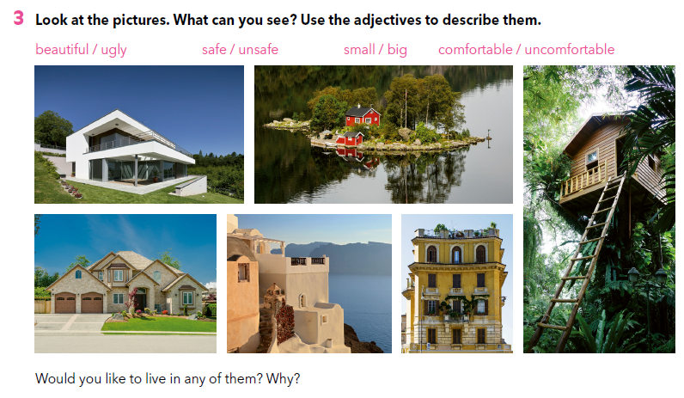

Slide 7
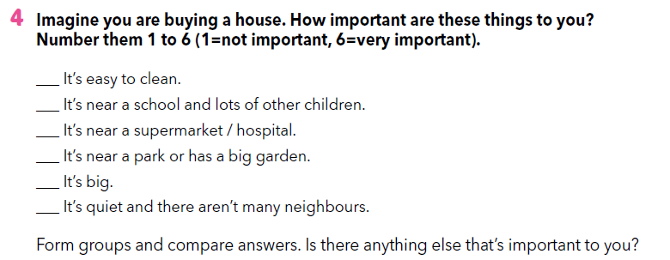

Slide 8
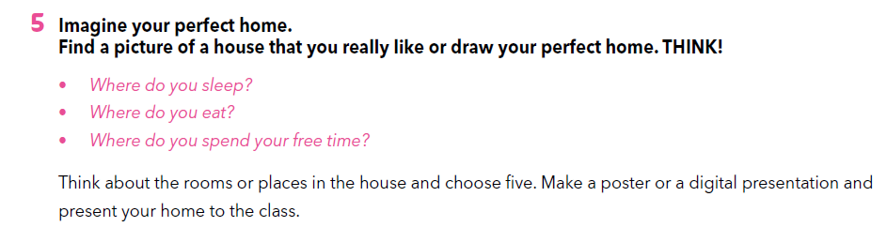

Slide 9
SELF CHECK
https://www.e-sfera.hr/dodatni-digitalni-sadrzaji/30028675-8c9e-4f9e-a1a6-3bc6c2f60aab/

